Slide 1
Distributed Shared Memory

Slide 2
Distributed Shared Memory
Making the main memory of a cluster of computers look as though it is a single memory with a single address space.
Then can use shared memory programming techniques.

Slide 3
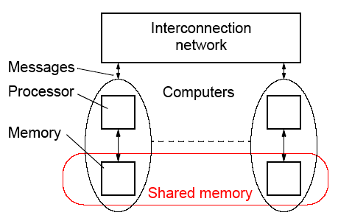
DSM System
Still need messages or mechanisms to get data to processor, but
these are hidden from the programmer:

Slide 4
Advantages of DSM
• System scalable
• Hides the message passing - do not explicitly specific sending
messages between processes
• Can use simple extensions to sequential programming
• Can handle complex and large data bases without replication
or sending the data to processes

Slide 5
Disadvantages of DSM
• May incur a performance penalty
• Must provide for protection against simultaneous access to
shared data (locks, etc.)
• Little programmer control over actual messages being generated
• Performance of irregular problems in particular may be difficult

Slide 6
Methods of Achieving DSM
• Hardware
Special network interfaces and cache coherence circuits
• Software
Modifying the OS kernel
Adding a software layer between the operating system and the application - most convenient way for teaching
purposes

Slide 7
Software DSM Implementation
• Page based - Using the system’s virtual memory
• Shared variable approach- Using routines to access
shared variables
• Object based- Shared data within collection of objects.
Access to shared data through object oriented discipline
(ideally)

Slide 8
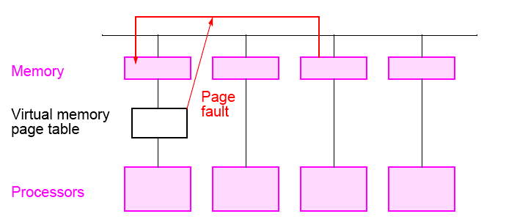
Software Page Based DSM Implementation

Slide 9
Some Software DSM Systems
• Treadmarks
Page based DSM system
Apparently not available now
• JIAJIA
C based
Obtained at UNC-Charlotte but required significant
modifications for our system (in message-passing calls)
• Adsmith object based
C++ library routines
be installed for teaching

Slide 10
JIAJIA
http://www-users.cs.umn.edu/~tianhe/paper/dist.htm
Characteristics:
  Physical memories of multiple workstations are combined to form a larger shared space. In other recent DSM systems such as Quarks, TreadMarks, and CVM the shared address space is limited by the size of local main memory. In JIAJIA, the size of shared space can be as large as the sum of each machine's local memories.
  A locked-based cache coherence protocol for scope consistency is proposed to simplify the design. Our protocol is lock-based because it totally eliminates directory and all coherence related actions are taken through accessing write notices kept on the lock. Compared to the directory-based protocol, the lock-based protocol is simpler and consequently more efficient and scalable.
  A new NUMA-like memory organization scheme which is taken to ease shared memory management. With the simplicity of this shared memory organization scheme and of scope consistency semantics, JIAJIA totally eliminates the complexity of diffs keeping, garbage collection, local address to global address tranisition, and vector timestamp maintenance.
  A flexible shared memory allocation call is provided to allow the programmer to control the distribution of shared locations.

Slide 11
Platforms
    Currently, JIAJIA runs on SUN SPARCstations running SUNOS4.1.3, Solaris 2.4 or above, IBM SP2 with AIX4.1, Dawning 1000A with AIX 4.1, Dawning 2000I with AIX 4.2, X86-based Linux 2.0 and Windows NT.
People Involved with JIAJIA
    JIAJIA was primarily developed by Prof. Weiwu Hu and Weisong Shi, under the direction of Prof. Zhimin Tang at the Center of High Performance Computing, Institute of Computing Technology, Chinese Academy of Sciences. Zhiyu Zhou ported some applications to JIAJIA. Tian He ported JIAJIA to Windows NT.

Slide 12
Consistency Models
• Strict Consistency - Processors sees most recent update,
i.e. read returns the most recent wrote to location.
• Sequential Consistency - Result of any execution same as
an interleaving of individual programs.
• Relaxed Consistency- Delay making write visible to reduce
messages.
• Weak consistency - programmer must use synchronization
operations to enforce sequential consistency when
necessary.
• Release Consistency - programmer must use specific
synchronization operators, acquire and release.
• Lazy Release Consistency - update only done at time of
acquire.

Slide 13
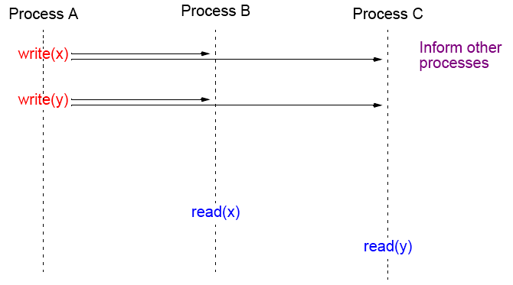
Strict Consistency
Every write immediately visible
Disadvantages: number of messages, latency, maybe unnecessary.

Slide 14
Consistency Models used on DSM Systems
Release Consistency
An extension of weak consistency in which the synchronization
operations have been specified:
• acquire operation - used before a shared variable or variables
are to be read.
• release operation - used after the shared variable or variables
have been altered (written) and allows another process to
access to the variable(s)
Typically acquire is done with a lock operation and release by an
unlock operation (although not necessarily).

Slide 15
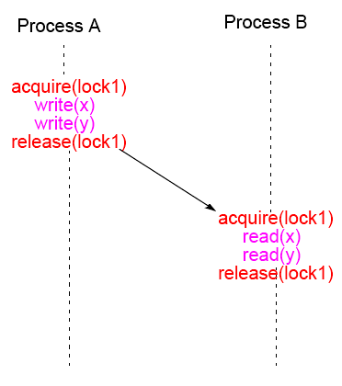
Release Consistency

Slide 16
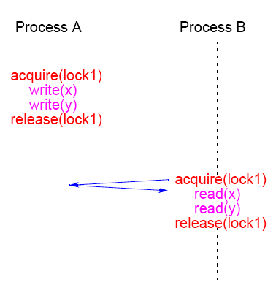
Lazy Release Consistency
Advantages: Fewer messages

Slide 17
Adsmith

Slide 18
Adsmith
• User-level libraries that create distributed shared memory system
on a cluster.
• Object based DSM - memory seen as a collection of objects that
can be shared among processes on different processors.
• Written in C++
• Built on top of pvm
• Freely available
User writes application programs in C or C++ and calls Adsmith
routines for creation of shared data and control of its access.

Slide 19
Adsmith Routines
These notes are based upon material in Adsmith User Interface document.

Slide 20
Initialization/Termination
Explicit initialization/termination of Adsmith not necessary.

Slide 21
Process
To start a new process or processes:
adsm_spawn(filename, count)
Example
adsm_spawn(“prog1”,10);
starts 10 copies of prog1 (10 processes). Must use Adsmith routine to start a new process. Also version of adsm_spawn() with similar parameters to pvm_spawn().

Slide 22
Process “join”
adsmith_wait();
will cause the process to wait for all its child processes (processes it created) to terminate.
Versions available to wait for specific processes to terminate, using pvm tid to identify processes. Then would need to use the pvm form of adsmith() that returns the tids of child processes.

Slide 23
Access to shared data (objects)
Adsmith uses “release consistency.” Programmer explicitly needs to control competing read/write access from different processes.
Three types of access in Adsmith, differentiated by the use of the
shared data:
• Ordinary Accesses - For regular assignment statements
accessing shared variables.
• Synchronization Accesses - Competing accesses used for
synchronization purposes.
• Non-Synchronization Accesses - Competing accesses, not
used for synchronization.

Slide 24
Ordinary Accesses - Basic read/write actions
Before read, do:
adsm_refresh()
to get most recent value - an “acquire/load.” After write, do:
adsm_flush()
to store result - “store”
Example
int *x; //shared variable
.
.
adsm_refresh(x);
a = *x + b;

Slide 25
Synchronization accesses
To control competing accesses:
• Semaphores
• Mutex’s (Mutual exclusion variables)
• Barriers.
available. All require an identifier to be specified as all three class instances are shared between processes.

Slide 26
Semaphore routines
Four routines:
wait()
signal()
set()
get().
class AdsmSemaphore {
public:
AdsmSemaphore( char *identifier, int init = 1 );
void wait();
void signal();
void set( int value);
void get();
};

Slide 27
Mutual exclusion variables – Mutex
Two routines
lock
unlock()
class AdsmMutex {
public:
AdsmMutex( char *identifier );
void lock();
void unlock();
};

Slide 28
Example
int *sum;
AdsmMutex x(“mutex”);
x.lock();
adsm_refresh(sum);
*sum += partial_sum;
adsm_flush(sum);
x.unlock();

Slide 29
Barrier Routines
One barrier routine
barrier()
class AdsmBarrier {
public:
AdsmBarrier( char *identifier );
void barrier( int count);
};

Slide 30
Example
AdsmBarrier barrier1(“sample”);
.
.
barrier1.barrier(procno);

Slide 31
Non-synchronization Accesses
For competing accesses that are not for synchronization:
adsm_refresh_now( void *ptr );
And
adsm_flush_now( void *ptr );
refresh and flush take place on home location (rather than locally) and immediately.

Slide 32
Features to Improve Performance
Routines that can be used to overlap messages or reduce number of messages:
• Prefetch
• Bulk Transfer
• Combined routines for critical sections

Slide 33
Prefetch
adsm_prefetch( void *ptr )
used before adsm_refresh() to get data as early as possible.
Non-blocking so that can continue with other work prior to issuing refresh.

Slide 34
Bulk Transfer
Combines consecutive messages to reduce number. Can apply
only to “aggregating”:
adsm_malloc( AdsmBulkType *type );
adsm_prefetch( AdsmBulkType *type )
adsm_refresh( AdsmBulkType *type )
adsm_flush( AdsmBulkType *type )
where AdsmBulkType is defined as:
enum AdsmBulkType {
adsmBulkBegin,
AdsmBulkEnd
}
Use parameters AdsmBulkBegin and AdsmBulkEnd in pairs to
“aggregate” actions.
Easy to add afterwards to improve performance.

Slide 35
Example
adsm_refresh(AdsmBulkBegin);
adsm_refresh(x);
adsm_refresh(y);
adsm_refresh(z);
adsm_refresh(AdsmBulkEnd);

Slide 36
Routines to improve performance of critical sections
仲裁和共享对象不在一个服务器，会出现每次操作都是两条消息

Slide 37
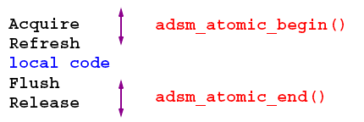
Routines to improve performance of critical sections
Called “Atomic Accesses” in Adsmith.
adsm_atomic_begin()
adsm_atomic_end()
Replaces two routines and reduces number of messages.

Slide 38
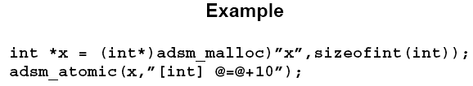
Sending an expression to be executed on home process
Can reduce number of messages. Called “Active Access” in
Adsmith. Achieved with:
adsm_atomic(void *ptr, char *expression);
where the expression is written as [type] expression.
Object pointed by ptr is the only variable allowed in the expression
(and indicated in this expression with the symbol @).

Slide 39
Collect Access
Efficient routines for shared objects used as an accumulator:
void adsm_collect_begin(void *ptr, int num);
void adsm_collect_end(void *ptr);
where num is the number of processes involved in the access, and *ptr points to the shared accumulator
Example
(from page 10 of Adsmith User Interface document):
int partial_sum = ... ; // calculate the partial sum
adsm_collect_begin(sum,nproc);
sum+=partial_sum; //add partial sum
adsm_collect_end(sum); //total; sum is returned

Slide 40
Other Features
Pointers
Can be shared but need to use adsmith address translation routines to convert local address to a globally recognizable address and back to an local address:
To translates local address to global address (an int)
int adsm_gid(void *ptr);
To translates global address back to local address for use by
requesting process
void *adsm_attach(int gid);

Slide 41
Message passing
Can use PVM routines in same program but must use
adsm_spawn() to create processes (not pvm_spawn(). Message tags MAXINT-6 to MAXINT used by Adsmith.

Slide 42
Information Retrieval Routines
For getting host ids (zero to number of hosts -1) or process id (zero to number of processes -1):
int adsm_hostno(int procno = -1);
- Returns host id where process specified by process number
procno resides. (If procno not specified, returns host id of calling
process).
int adsm_procno();
-Returns process id of calling process.
int adsm_procno2tid(int procno);
Translates process id to corresponding PVM task id.
int adsm_tid2procno(int tid)
translates PVM task id to corresponding process id.

Slide 43
DSM Implementation Projects
Using underlying message-passing software
• Easy to do
• Can sit on top of message-passing software such as MPI.

Slide 44
Issues in Implementing a DSM System
• Managing shared data - reader/writer policies
• Timing issues - relaxing read/write orders

Slide 45
Reader/Writer Policies
• Single reader/single writer policy - simple to do with
centralized servers
• Multiple reader/single writer policy - again quite simple
to do
• Multiple reader/multiple writer policy - tricky

Slide 46
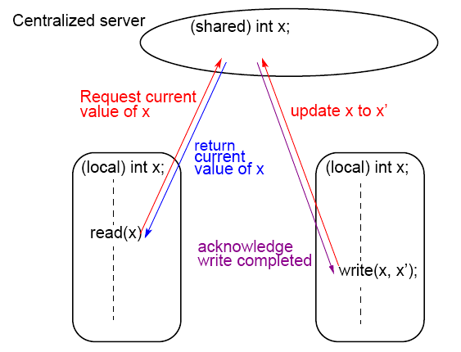
Simple DSM system using a centralized server

Slide 47
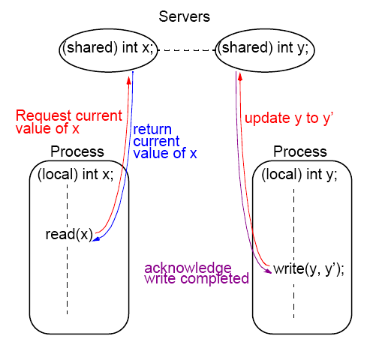
Simple DSM system using multiple servers

Slide 48
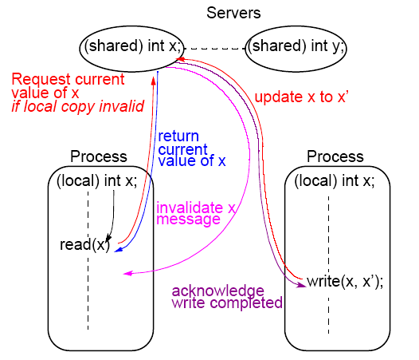
Simple DSM system using multiple servers and multiple reader policy

Slide 49
Shared Data with Overlapping Regions A New Concept Developed at UNC-Charlotte
Based upon earlier work on so-called over-lapping connectivity interconnection networks
A large family of scalable interconnection networks devised – all have characteristic of overlapping domains that nodes can
Interconnect
Many applications require communication to logically nearby
processors

Slide 50
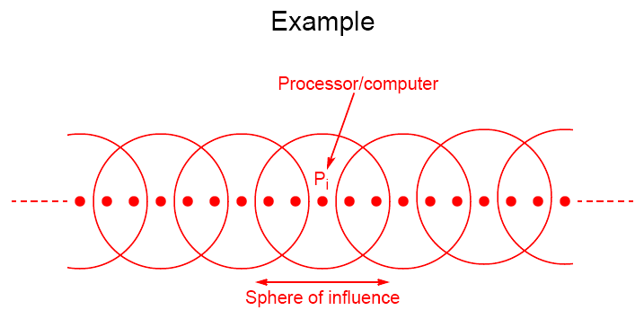
Overlapping Regions

Slide 51
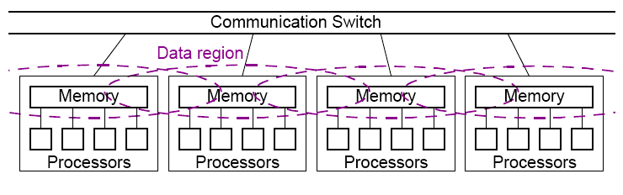
Symmetrical Multiprocessor System with
Overlapping Data Regions

Slide 52
Static and Dynamic Overlapping Groups
• Static - defined prior to program execution – add
routines for declaring and specifying these groups
• Dynamic - shared variable migration during program
execution

Slide 53
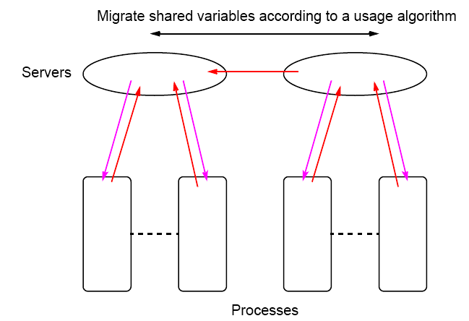
Shared Variable Migration between Data Regions

Slide 54
DSM Projects
• Write a DSM system in C++ using MPI for the underlying
message-passing and process communication.
• Write a DSM system in Java using MPI for the underlying
message-passing and process communication.
• (More advanced) One of the fundamental disadvantages of
software DSM system is the lack of control over the
underlying message passing. Provide parameters in a DSM
routine to be able to control the message-passing. Write
routines that allow communication and computation to be
overlapped.

Slide 55
Assignment in class
1. 请用公式推导Amdahl定律？并用实例解释Amdahl定律。
2. 请用实例解释伯恩斯坦条件。

